Slide 1
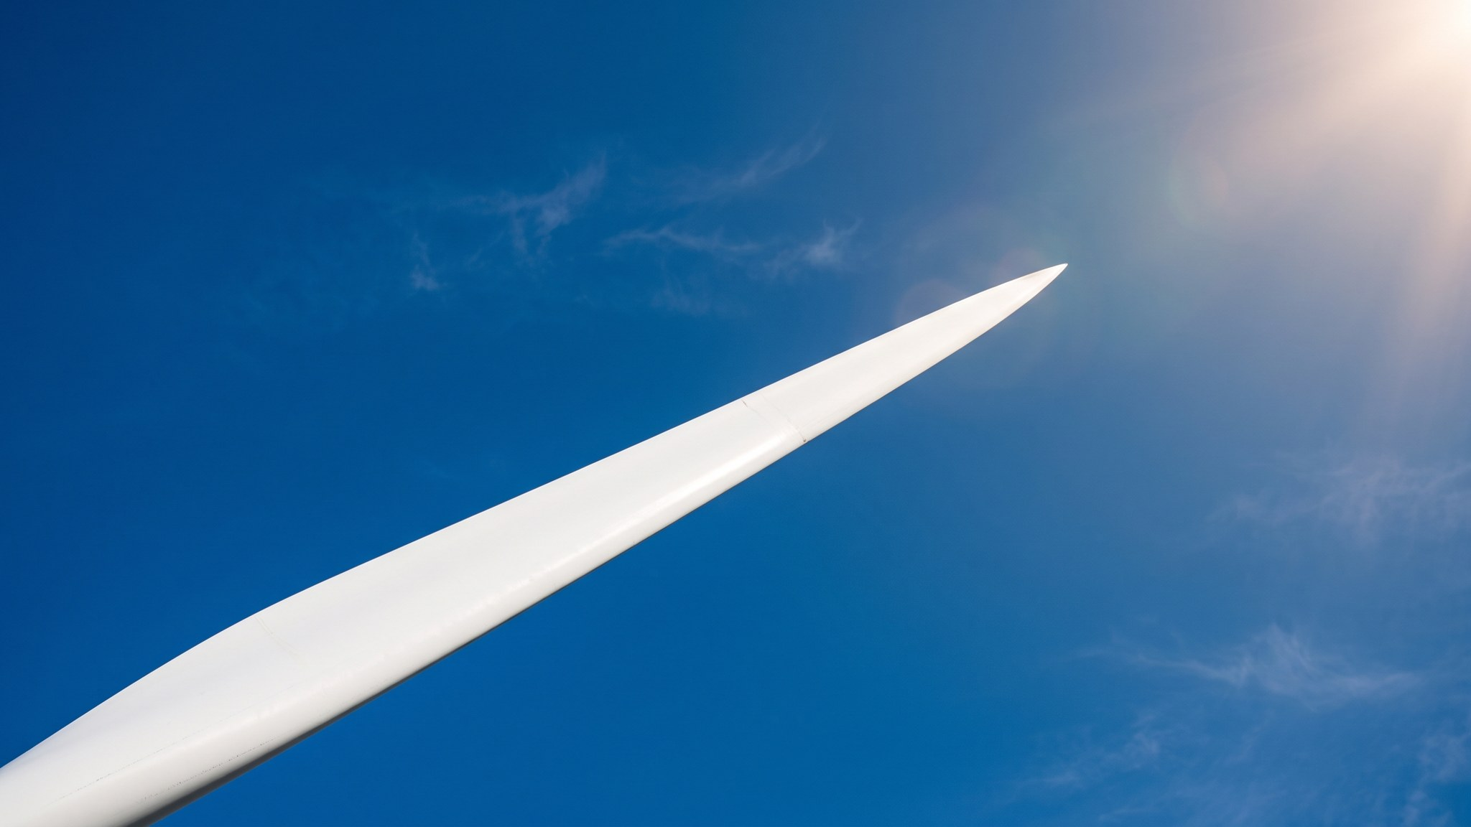
WEYLAND ENERGY
Our brand in 10 slides
Brand guidelines v3.0 – all-staff briefing, 27 January 2026

Slide 2
Why we refreshed the brand
• Moved from developer to builder-operator: Harrow Bay FID planned for February 2026
• Old templates had 14 colour variants and three logo files in circulation
• Documents must look identical in Office, LibreOffice and OpenCloud previews
• Same story for lenders, neighbours and new hires
WEYLAND ENERGY · Our brand in 10 slides
2
Notes:
Keep this short – most people only want to know where the templates are.

Slide 3
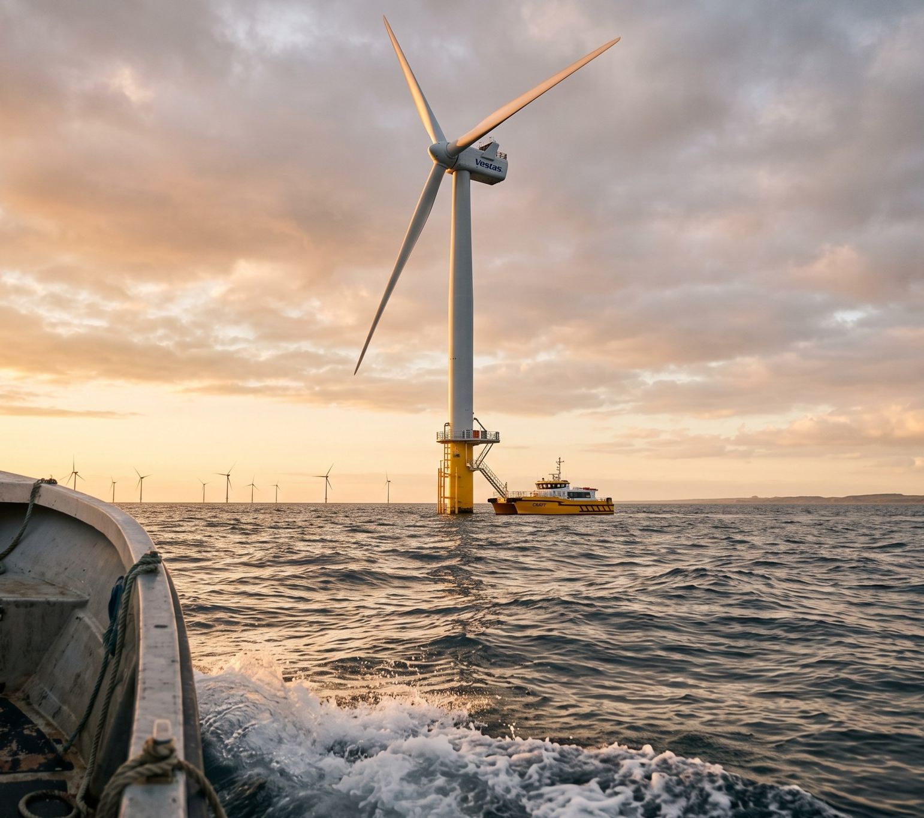
The logo
• Rising sun over two waves – sun and sea
• Wordmark in lower case Arial Bold
• Six variants – default is the primary horizontal logo
• Clear space = height of the sun
WEYLAND ENERGY · Our brand in 10 slides
3

Slide 4
Colours
Colour | HEX | Use
Deep Sea | #0B3C5D | Primary – headlines, title bars, logo
Teal | #1FA2A6 | Accent – links, highlights, waves
Sun | #F2B134 | Highlight – key figures, charts, symbol
Mist | #EEF3F6 | Light backgrounds, table stripes
Slate | #4A5A68 | Body text, captions, UI grey
Coral | #E4572E | Warnings, negative values (sparingly)
Leaf | #5BA65B | Positive values, nature topics
WEYLAND ENERGY · Our brand in 10 slides
4

Slide 5
Type
• Arial everywhere – no exceptions, no downloads needed
• Bold for headlines, Regular for text
• Sentence case in headlines
• Key figures in Sun or Deep Sea, never in Coral unless negative
WEYLAND ENERGY · Our brand in 10 slides
5

Slide 6
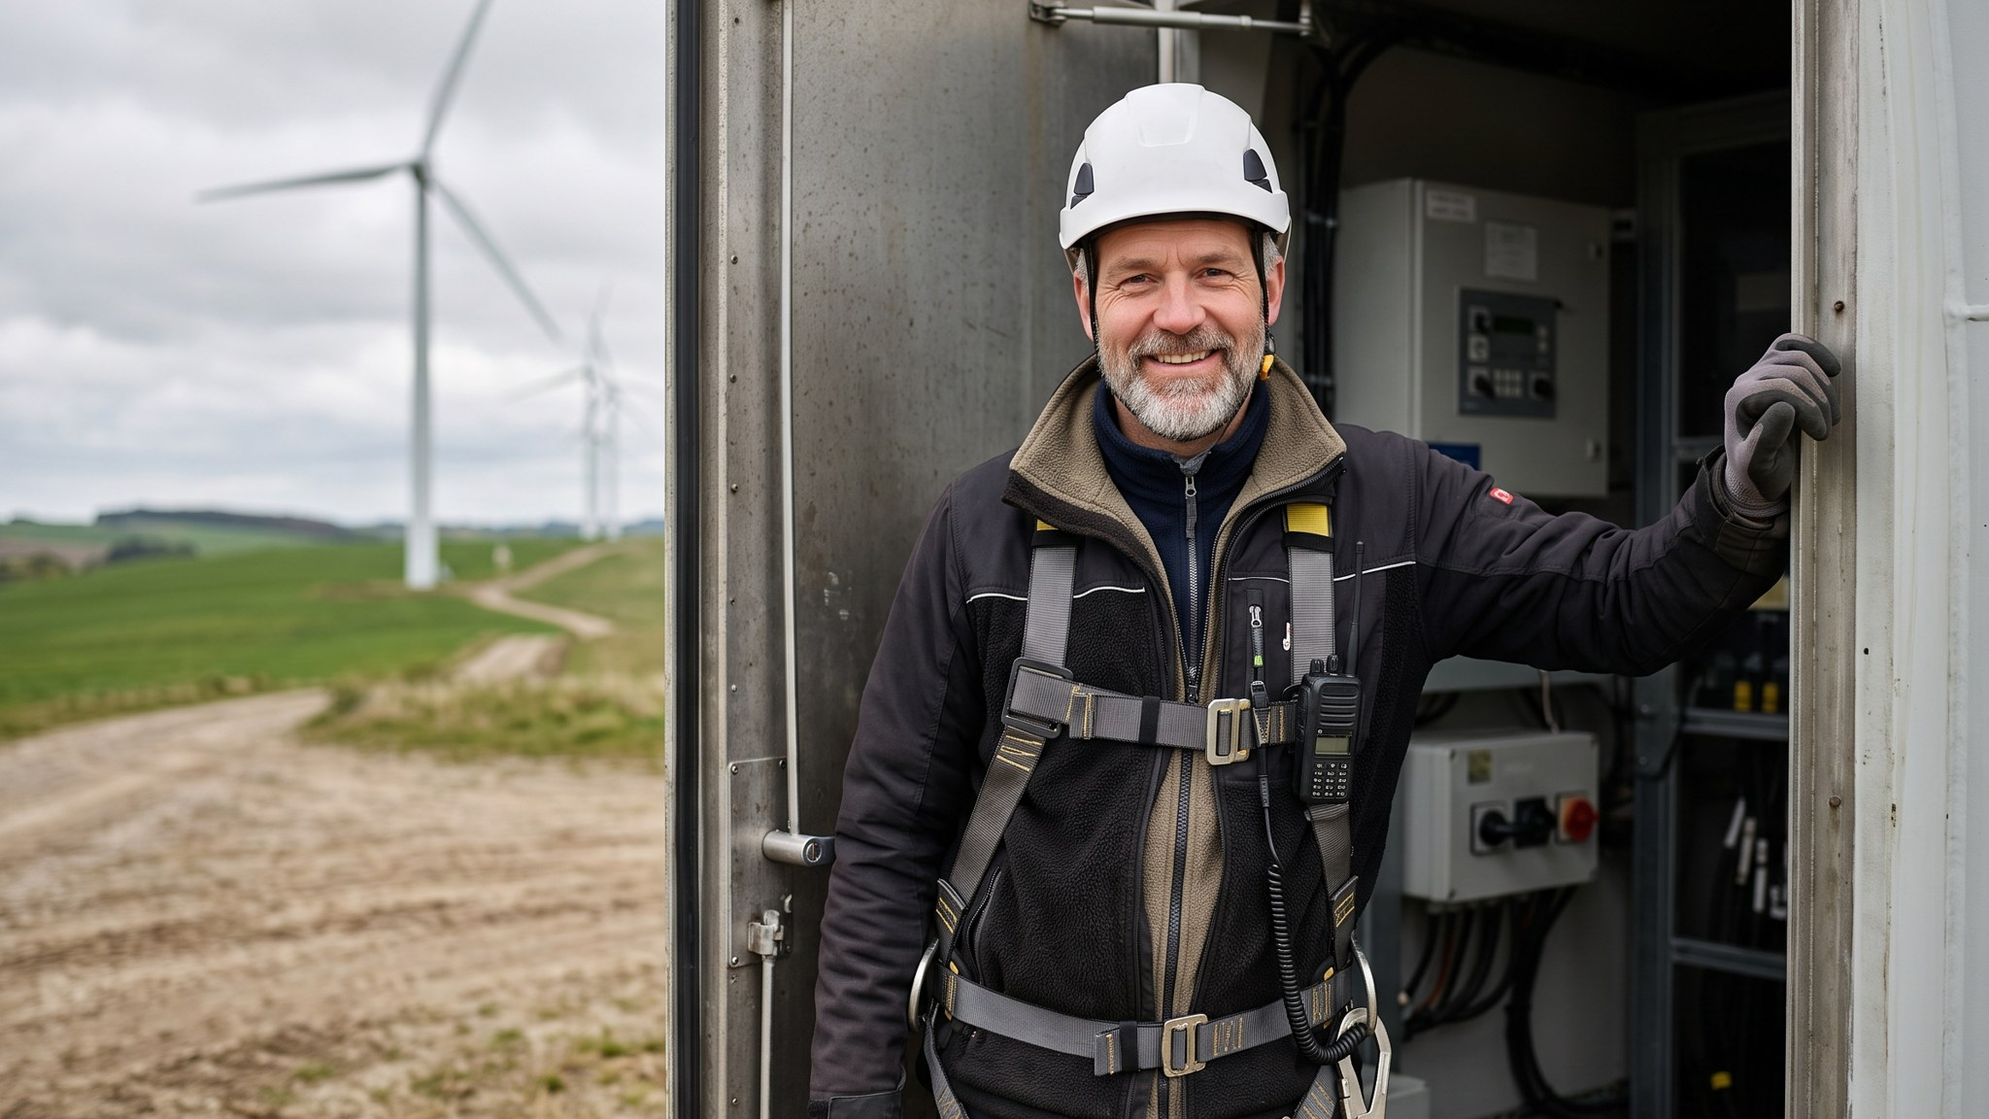
Photography
Real people, real sites, correct PPE – always

Slide 7
“Say what we built, what it means for people, and what comes next.”
— Tone of Voice Guide, principle 1
WEYLAND ENERGY · Our brand in 10 slides
7

Slide 8
By the numbers
6
7
8
2 days
logo variants
brand colours
slide layouts
review turnaround
WEYLAND ENERGY · Our brand in 10 slides
8

Slide 9
Where to find everything
• OpenCloud space Brand Assets – Logos, Colours, Templates, Photography, Icons
• Old templates in Office/LibreOffice: please delete them
• Questions: Noah Fischer, Ravi Shah
WEYLAND ENERGY · Our brand in 10 slides
9

Slide 10
WEYLAND ENERGY
Clean power, built to last.
Thank you

